Slide 1

Credit Card Fraud Analysis and Modelling
T. Waldin
Notes:
Hi everyone, I’m going to be presenting my capstone project on…

Slide 2

A fraudulent transaction is a transaction not authorised by the credit card holder.
Notes:
$$$ goes missing, people lose trust in providers

Slide 3

Credit card providers can use machine learning to detect fraudulent transactions.
Notes:
And can block transactions or freeze or cancel cards or notify the user. What I have been trying to do is generate…

Slide 4

Dataset obtained from kaggle.
Dataset is generated from a simulation, as real data has privacy implications and sensitive features. There are application limitations due to this.
Approximately 500,000 rows and 23 features.
Notes:
Notes on screen. So looking into this dataset..

Slide 5
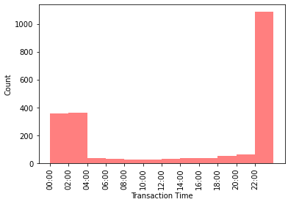

Fraudulent transactions tend to occur between 10pm and 4am.

Slide 6
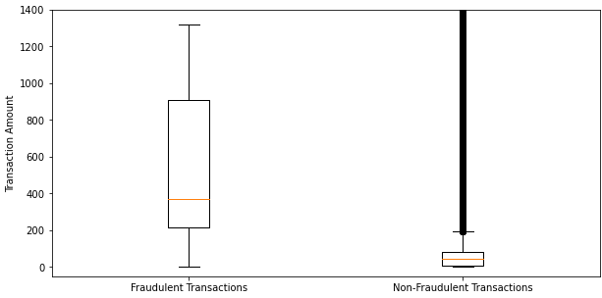
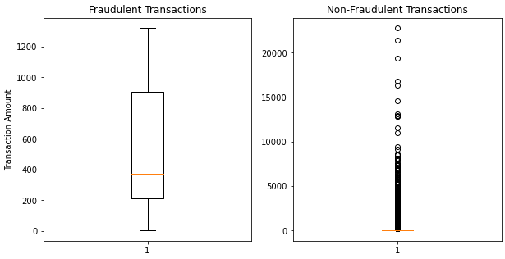

Fraudulent transactions tend to be on average of a greater amount.

Slide 7
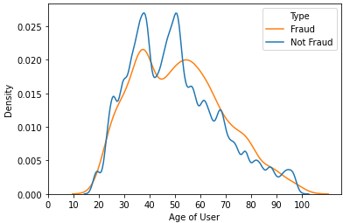
Older people tend to be more at risk of fraudulent transactions.

Slide 8
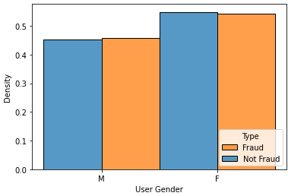
Gender tends to not be a factor.

Slide 9
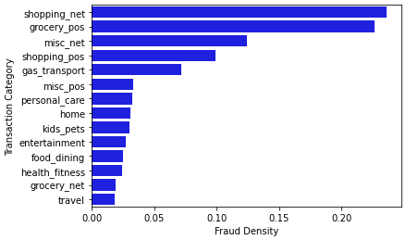
Some transaction categories tend to have higher rates of fraud than others.

Slide 10
Fraudulent transactions are often anomalies.
A sudden increase in spending
Purchase of a large ticket item
A series of rapid transactions
Multiple transactions with the same merchant
Transactions that originate in an unusual location or foreign country
Transactions that occur at unusual times
Notes:
I did some research into how fraud is detected in industry and found… …. I used these as the basis for my feature enginnering

Slide 11
Feature engineering to detect anomalies.
time_unusual = 1 when time of transaction is between 10pm and 4am and 0 otherwise.
interval = minimum difference in time with the transaction before or after it
cons_merchant = the number of consecutive transactions with the same merchant prior to the transaction.
diff_long and diff_lat = the difference in latitude or longitude between the user’s home and the merchant.

Slide 12
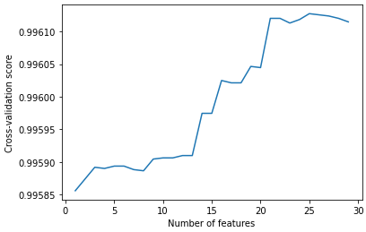
The features were selected using a SelectKBest with an ‘f_classif’ score function. 25 features were selected.

Slide 13
Four different models were used.
Elliptic Envelope: detects outliers in a dataset by modelling the data distribution as an elliptical shape.
Isolation Forest: a decision tree-based algorithm that isolates anomalies in a dataset by randomly selecting features and splitting points.
One-Class SVM: a support vector machine algorithm that separates the normal data from outliers by constructing a hyperplane that maximizes the margin around the normal data.
SGD One-Class SVM: an optimization algorithm that uses stochastic gradient descent to solve the one-class SVM problem efficiently on large datasets.

Slide 14
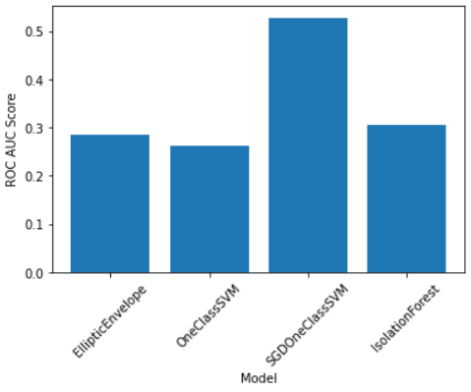
The SGD One-Class SVM performed significantly better than the other models on the training data.

Slide 15
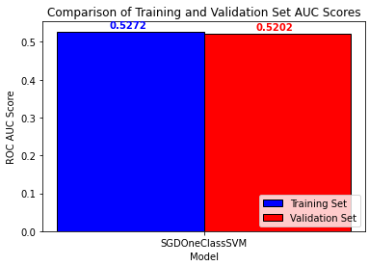
Model is possibly overfitting.

Slide 16
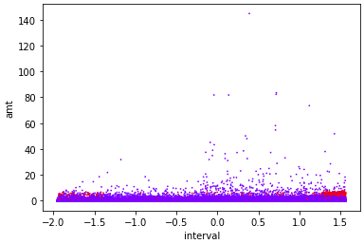
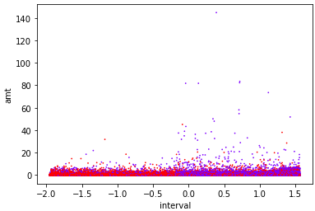
The model has an ROC AUC score of 0.5288 on the test set. This is effectively no better than random.

Slide 17


- Performance needs significant improvement to have real world applications. - A grid search is computationally expensive, and the model is not performing well enough to warrant one. - Performance increases would likely be found in feature engineering and feature selection.

Slide 18
The SGD One Class SVM model performed the best out of the models generated. It was shown that the model generated could not identify fraudulent transactions to any significant degree. The model has potential to be improved through more thorough feature engineering and feature selection.
Thank you. Any questions?
Notes:
And to sum up…

